Slide 1
Practical Methods to Integrate Transportation-Land Use / Regional Economics with a Travel Demand Model for Evaluating Policy Outcomes at the Atlanta Regional Commission
TRB Transportation Planning Applications Conference
Portland, Oregon, June 2019
Guy Rousseau, Atlanta Regional Commission
grousseau@atlantaregional.org

Slide 2
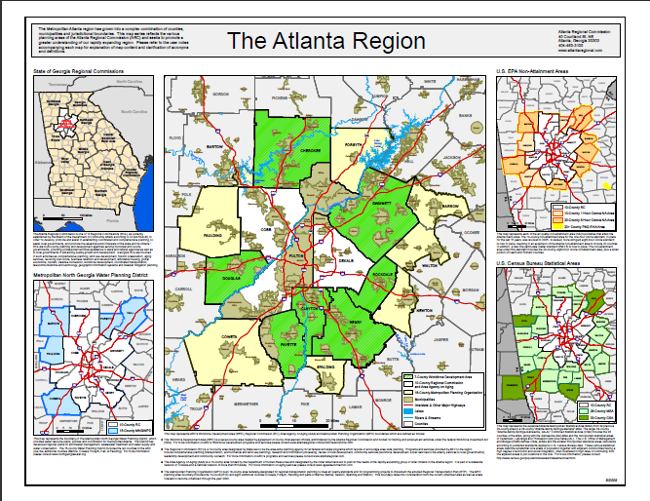


The Atlanta “Region”, A Complex Geography
10-County RDC
20-County NA
15-County MNGWPD
33-County CMSA
Notes:
Background:
The Atlanta Regional Commission (ARC) is the regional planning and intergovernmental coordination agency for the 10-county area including Cherokee, Clayton, Cobb, DeKalb, Douglas, Fayette, Fulton, Gwinnett, Henry and Rockdale counties, as well as the City of Atlanta. The We are the Regional Leader in identifying Values, developing Policies and executing Plans that matter to residents and communities. The ARC will continue to provide forward looking leadership to ensure sustainable growth and competitive advantage by focusing and balancing Environmental Responsibility, Economic Growth, and Social Needs. In providing these elements to our citizens and planning partners, we are charged with coordinating on many geographic levels and serve as the (click)
The 10-county Regional Development Center functioning as the comprehensive land use planning agency collectively advising local jurisdictions on decisions and actions that impact the entire region. (click)
As the federally-designated Metropolitan Planning Organization for the 18-county Region and govern the 20-county Non-Attainment area, we are responsible for developing a multi-modal, financially constrained transportation plan that meets the Clean Air planning requirements. (click)
Also, the ARC is designated by the U.S. Office of Management and Budget as the 33-county Combined Metropolitan Statistical area committed towards planning for high degrees of social and economic integration through commuting sheds. (click)
Last, we house the Region’s 15-county Metropolitan North Georgia Water Planning district which develops regional and watershed-specific plans for stormwater management, wastewater treatment and water supply and conservation promoting intergovernmental coordination of all water issues in the District from a regional perspective. (click)
All of this makes up the Atlanta Region and we as the official metropolitan planning entity are responsible for all of these elements.
Need: It is essential to understand all data mined, collected and cataloged within your group, agency or company to fully leverage the capabilities of the REMI models. Whether the data are used to compare, constrain or validate the data endogenous to the model.

Slide 3
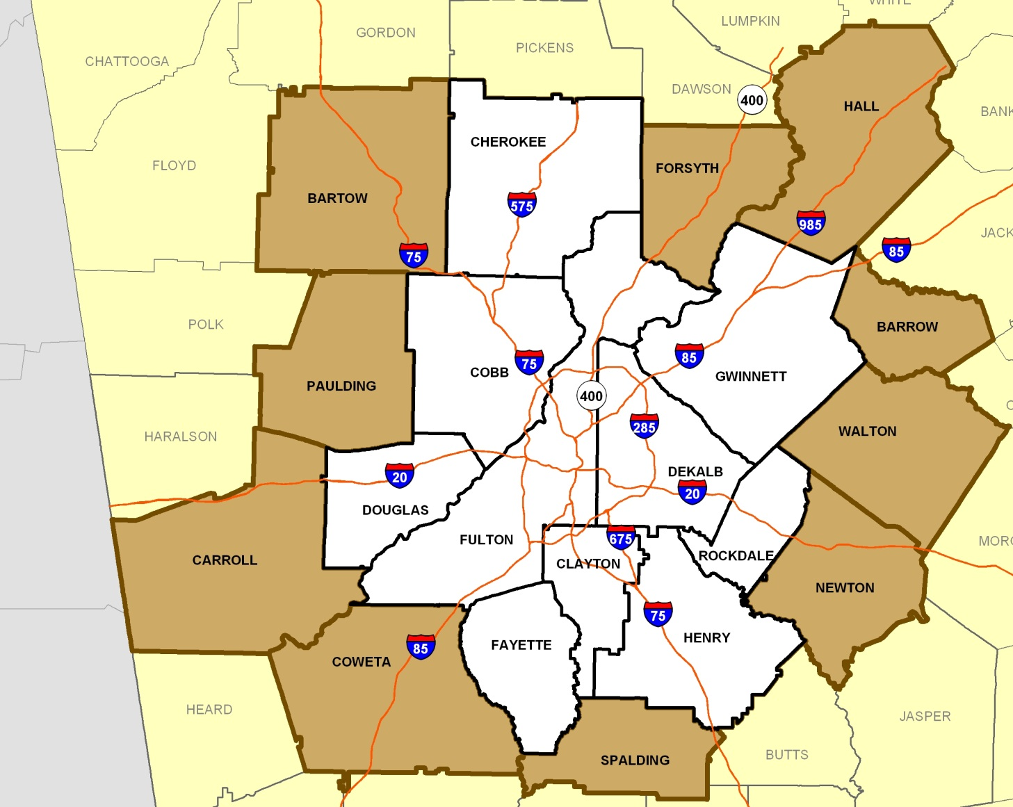
The Regional Forecast Area
Baseline Statistics
Total Pop: 5,500,000 Total Emp: 2,250,000 Total Area: 6,400 sq. mi.
Notes:
We are designated by the state as one of 12 regional commissions to coordinate land use planning and development amongst the state’s counties. Every county in Georgia is a member of one of these 12 regional commissions. ARC’s 10-county area is represented in white on this map.
ARC is probably best known for its involvement in metro Atlanta’s transportation planning. ARC is designated by the federal government as the metropolitan planning organization, or MPO, for the “urbanized Atlanta region.” The “urbanized area” is determined every 10 years by the U.S. Census Bureau. Currently, the Atlanta urbanized area covers these 20 counties. Soon it will grow to include all or parts of 23 counties based on the 2010 Census.
Being the MPO means that all the federal transportation money for our 20 counties comes through ARC. So, if you’re a local jurisdiction and you want to use any federal dollars for transportation, your project or program has to be in the region’s plans.
Along with land use and transportation, we also have many other federal and state designations. The acronyms for all of these would cause your head to spin: the AAA, the ARWB, the EDD, the MNGWPD, the MAPDC, and… well, you get the picture. A bunch of official government stuff. What it really means is that we are involved in many aspects of life in metro Atlanta: land use planning and community development; water supply planning, water conservation and water quality; services for our rapidly aging and disabled populations; development of a workforce that is ready to tackle the jobs of today and tomorrow.
So, it’s through this very broad lens that ARC views the regional community. And, it’s through this lens that I would like to speak to you today.

Slide 4
ARC Forecast Flow
Transportation conditions
REMI
Land use changes & spatial performance
PECAS
Transportation conditions
Regional SE forecast
Integration
ABM
Small area SE forecast
Transportation forecast
Forecast
Future improvements
REMI TranSight Economic Analysis

Slide 5
Basic Spatial Economy
Goods and Services
Market
Travel
Travel
Business Establishments
Households
Labor
Market
Travel
Non Residential Space
Residential Space
Developers
Land

Slide 6
Economy
Economic conditions affect location choices and vice versa.
Travel choices and network conditions affect Economic conditions and vice versa.
Land Use
Transport
Travel choices and network conditions affect location choices and vice versa.

Slide 7
ED
Regional economy and demography
ED
Regional economy and demography
changes in basic economic conditions;
changes in person and household cohorts
activity totals
consumer
surplus
development activity
AA
Spatial activity allocations
AA
Spatial activity allocations
space
rents
SD
space development microsimulation
space
quantities
SEM: spatial economic model
activity locations
activity interactions
transport
generalized
costs
PS
population
synthesis
PS
population
synthesis
synthetic population
TR
transport
model
TR
transport
model
changes in transport supply
TDM: transportation model
year t year t+1
Notes:
7

Slide 8
Comprehensive Analysis Pillars
Anticipating economic shifts for competitiveness & mobility
Convening decision-makers to assess policies
Addressing future unknowns through scenario planning
Economic
Policy
Forecasting

Slide 9
Integrated Model Features
Integrated
Model incorporates four quantitative methodologies
Dynamic
Measures economic impacts and responsive demographic and economic changes over time
Structural
Incorporate transparent and robust economic linkages built on proven methods and theory
Customizable
Each model is custom built to match regional and sub-regional vetted data from adopted annual estimates or census data
Captures agglomeration and clustering
Notes:
Multiple quantitative methods to strengthen the model. Each method has its strengths and weaknesses, therefore using them together can compensate for some weaknesses and highlight the strengths. For example Input/output is good at changes in one period, but is not good for those changes over time.
Dynamic - makes the model non linear and interactive
Structure – transparent and not a black box

Slide 10
Integrated Model Methodologies
Input-Output Tabulations
Econometric
New Economic Geography
Computer General Equilibrium
Inter-industry behaviors
Long-term effects to bring markets back to “new” normal: Market clearing point where supply meets demand
Statistical parameters: Strength of responses from consumers; elasticity of demand & time lags for adjustments
Measures regional benefits: Regional benefits from agglomeration due to economic activity in terms of supply chain and labor forces

Slide 11
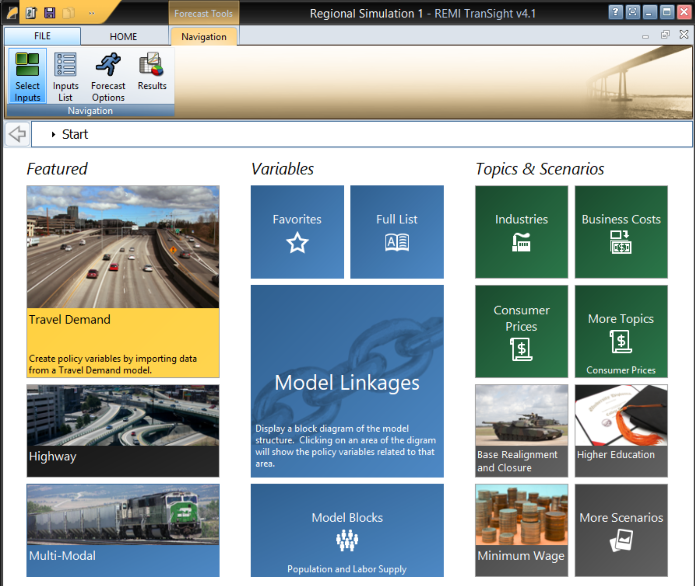
Model Input Options

Slide 12
Framework
Data
Collection
Development
Analysis
Full Build scenario
Assumptions
Translators
Calibrations
Simulations
No Build scenario
Alternative scenario
Concept
&
Scope
Assessment

Slide 13
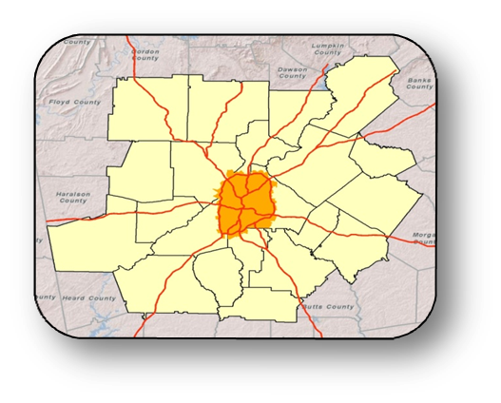
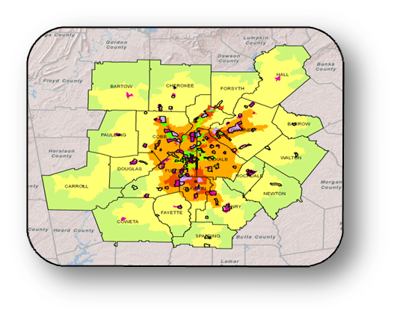
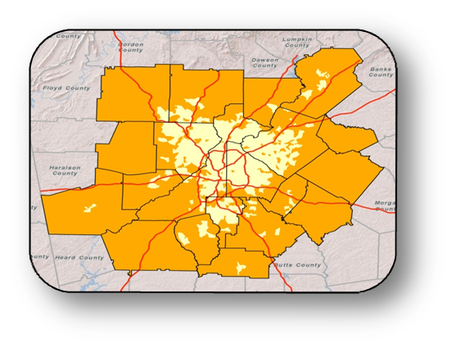




Growth Scenarios & Policies Examined
Base Case
Concentrated Growth
Urbanized Area
Sprawl
Water Constrained
Southside Growth
Local Policy (UGPM/LCI)
Transit Oriented Development

Slide 14
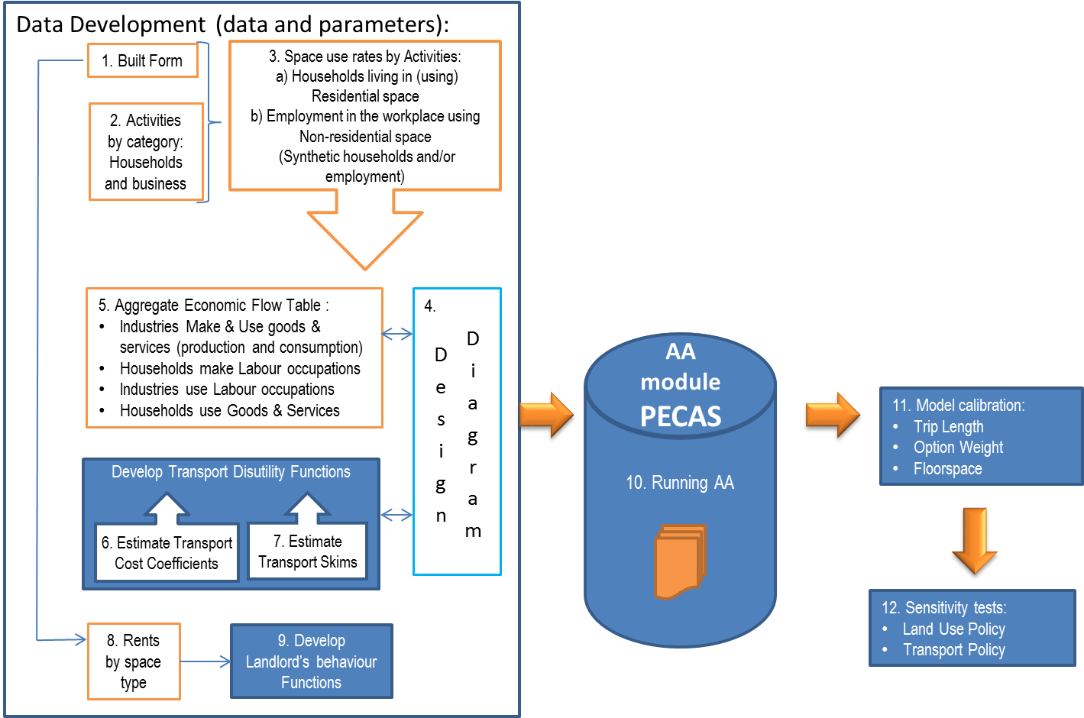
12 steps to AA

Slide 15



Atlanta’s Activity-Based Model: Tours and Trips
Work-Based Tour
Zone 1
Zone 3
Non-Home-Based Trip
Zone 4
Home-Based Work Trip
Work Tour
Non-Home-Based Trip
Origin
Origin
Primary
Destination
Primary
Destination
Home-Based
Other Trip
Non-Home-Based
Trip
Zone 2
Intermediate
Stop

Slide 16
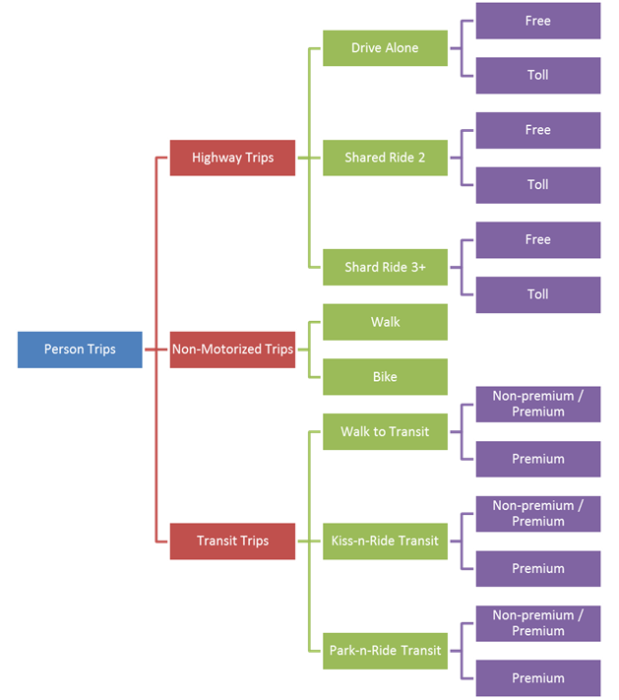
Atlanta’s
Treatment of Transport
Modes
Explicit toll versus non-toll choice in mode choice
School Bus is a trip mode for traffic assignment

Slide 17
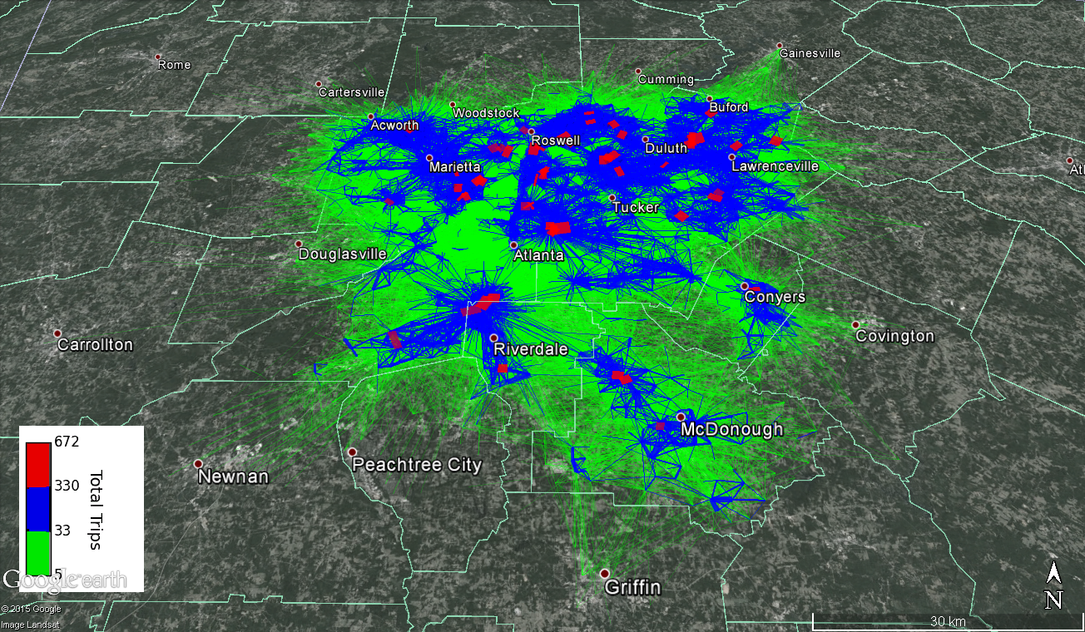
Atlanta’s Single-Occupant Vehicles
Origin-Destination Desire Lines

Slide 18
Workplace Location Choice Example
Atlanta’s Integrated Land Use / Transport Model
$1.5M
Labor Flow
5
Labor
Flow
Matrix
(beta zone)
1
3
4
=
6
2
Beta Zone 101
$0.25M Intrazonal
Beta Zone 201
$0.25M Intrazonal
 | 1 | 2 | 3 | 4 | 5 | 6
1 | 0.06 | 0.34 | 0.35 | 0.19 | 0.01 | 0.04
2 | 0.09 | 0.17 | 0.03 | 0.08 | 0.34 | 0.30
3 | 0.07 | 0.21 | 0.16 | 0.21 | 0.14 | 0.20
4 | 0.11 | 0.14 | 0.22 | 0.21 | 0.25 | 0.07
5 | 0.17 | 0.07 | 0.02 | 0.31 | 0.18 | 0.27
6 | 0.20 | 0.19 | 0.21 | 0.20 | 0.14 | 0.06
$ Production (alpha)
Mode Choice
Logsum
Matrix*
(alpha zone)
$ Consumption (alpha)
*The Mode Choice Logsum matrix take into account the time and cost of travel by all modes of transportation, according to traveler perceptions about the importance of the attributes of each mode, as well as non-included attributes that affect the probability of taking each mode between each origin-destination pair.

Slide 19
Atlanta’s Integrated Land-Use/Transport Model
2 Types of Linkages:
  Connection: Feeding Land-Use Model Estimates of Population and Employment to ABM
  Integration: Leveraging Labor Flows from Spatial Input-Output Model (PECAS) to Determine Workplace Location Choice

Slide 20
Goals of Land Use Model (PECAS) to Activity-Based Model (ABM) Integration
Small Area (TAZ) Land Use Estimates for Use in Destination Choice Models
  Employment for 20 Industrial Classifications
  Total Households
Synthetic Population Control Totals
  Household by Size and Income (TAZ Control)
  Workers by Occupation (LUZ Control)

Slide 21
Land use Model (PECAS) to Activity-Based Model (ABM) Integration
On the Land Use Side:
  ABM Takes Employment Projections from PECAS as Part of its Inputs
  Returns Accessibility Measures to PECAS once it Forecasts Travel Demand

Slide 22
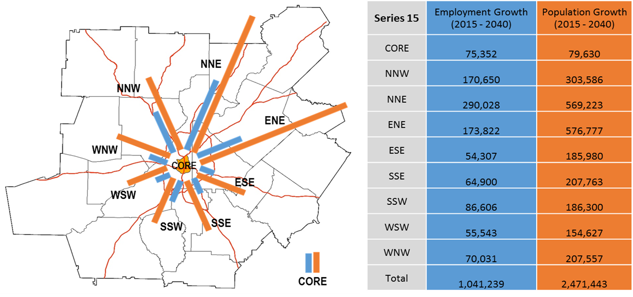

Directions of Growth, 2015-2040
Source: ARC Forecasts, series 15

Slide 23
Comparing Changes in North and South of I-20
Source: ARC Forecasts, series 15

Slide 24
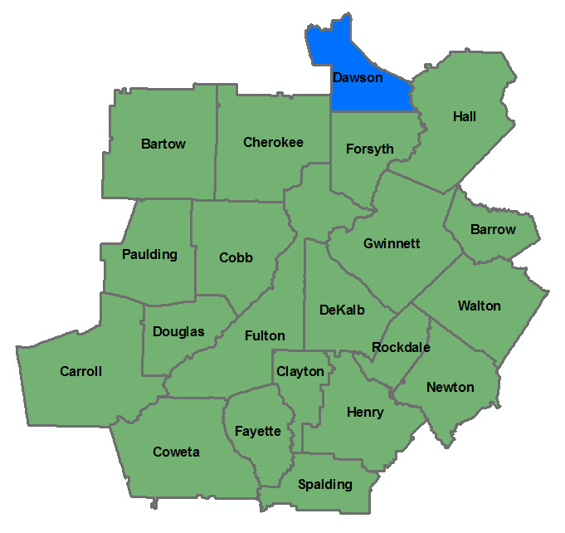
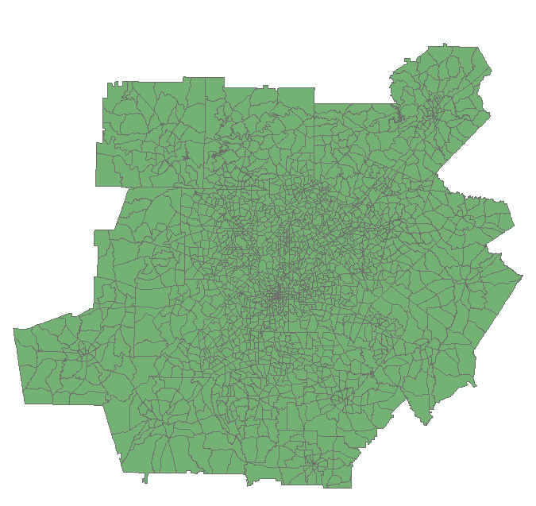
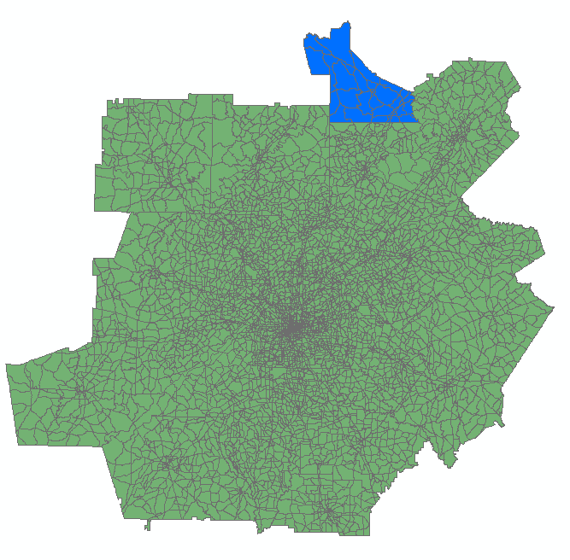
ARC Forecasts—Reviewing Why and What
Why we forecast?
-Key Component of RTP/ RDP/ WD Plans…
Regional SE forecasting
- REMI replaced IPEF
- 20 / 21 Counties
- Economic activities
- Households
- Population
- Employment
Small area SE forecasting
- PECAS/TAZD replaced DRAM/EMPAL
- 2,000 zones for TBM
- 6,000 zones for ABM
Transportation forecasting
-Migrated to
Activity Based Model
2,000 zones
6,000 zones

